Slide 1




MODERN HIGH SCHOOL DIDACTICS

Slide 2






Phenomena
A teacher has lost an exclusive
domain of knowledge
Students have received unlimited access
to information resources
Phenomenon of “red replacement” in broadening
of information and communication environment
Qualitative and quantitative differences in ICT-
competences of younger and senior generations
A teacher has lost an exclusive domain of knowledge
Students have received unlimited access to information resources
Phenomenon of “red replacement” in broadening of information and communication environment
Qualitative and quantitative differences in ICT-competences of younger and senior generations

Slide 3



New teaching technologies are characterized by transition:
1 STAGE: SUBJECT-OBJECT DIDACTICS
  Subject-object
  Linear
  Megabyte
Filling
Teacher
Student
with knowledge
Full
2 STAGE: SUBJECT- SUBJECT DIDACTICS
  Subject-subject
  Two-dimensional
  Gigabyte
Teacher
Student
partners
Full
Teacher
Student
partners
3 STAGE: THREE-SUBJECTIVE DIDACTICS
  Three-subjective
  Three-dimensional
  Terabyte
Environment

Slide 4
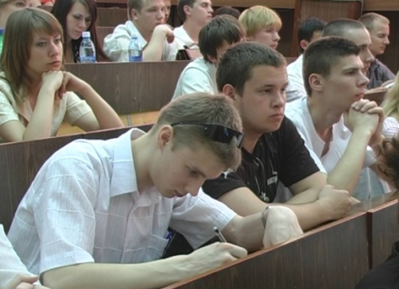
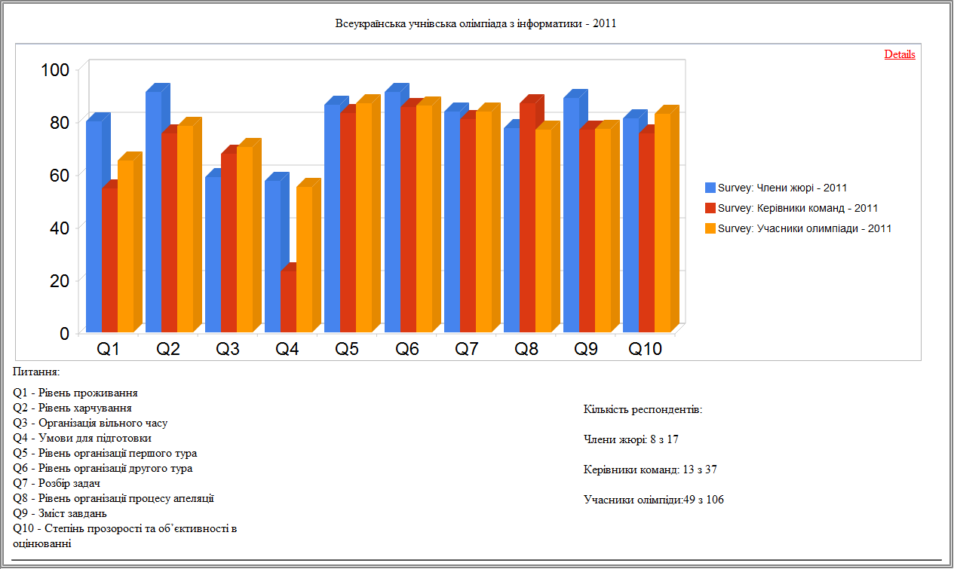

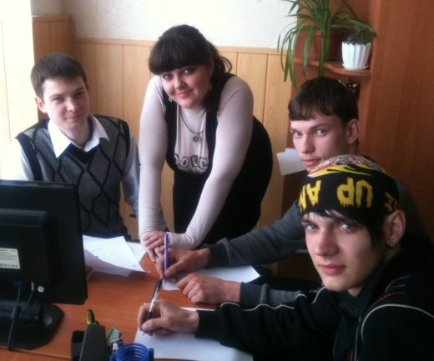


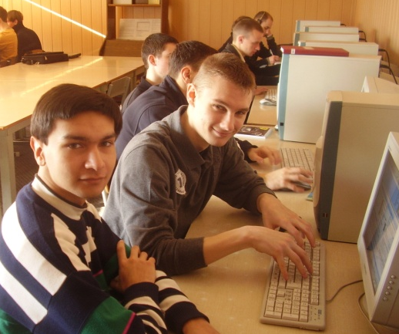

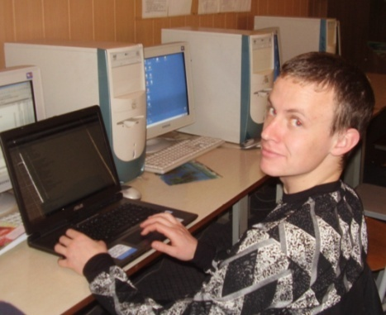
Basic principles of modern
University on the example of KSU
University – is a corporation which serves educational interests.
Motivation is a key way to successful expert knowledge.
University is a provider of global educational services.
Technologies are aimed to serve human welfare not vice versa.

Slide 5
Didactics as a theory of education and teaching
Subject of didactics.
Basic stages in the development of didactics (historical and logical approach).
Three-subjective didactics – qualitatively new and higher level in education and training theory development.

Slide 6
Educational aims and content under the condition of three-subjective environment
1
Typology and historical epochs in the development of education
2
Peculiarities of educational content in the course of transormation to three-subjective model of relationship
3
Fundamentals of curriculum construction
4
Interconnection between separate disciplines under the condition of information and communication educational environment.
Academic subjects’ content work-out
Brief characteristics of education on different stages of training
Educational content of separate academic subjects
Educational Content

Slide 7
Process of teaching
Education as a concept.
2
Competent character of education.
3
Role functions of teacher, student and information and communication environment under conditions of three-subjactive relationship.
4
The process of a future specialist’ competence forming.
5
The problem of students’ perseption of subjects and phenomena and edequate notion forming.
1

Slide 8
Process of teaching
Forming of concepts and questions connected with abstraction constructions.
7
The problem of knowledge and skills stability as a basis for the forming of professional competence.
8
Quasi-professional activities in the process of training.
9
Organization of feedback as two-sided process under the condition of information and communication educational environment.
10
Problems in forming of motivation in the process of studying.
6

Slide 9
Educational principles
Principle of scientific approach towards education
Principle of systematicness
Principle of individual approach while working in groups
Principle of connection between theory and practice
Traditional methods of teaching under the condition of three-subjective relationship
Principle of education accessibility
Principle of consciousness and activity
Principle of strong knowledge assimilation
Principle of visual methods use

Slide 10
Educational principles
Principle of divergence in the realization of personal educational trajectory
Principle of free access to educational resources
Principle of personal socio-informational immunity system forming
Principle of educational resources integration
Innovative educational principles
Principle of harmonization with the environment
Principle of knowledge globalization
Principle of asynchronism in modern education management models
Principle of WEB-multimedia presentation of educational information
Principle of global educational auditoriums organization
Principle of plurilinguism in the process of teaching
10

Slide 11
Creation the motivation
for active learning
Students’ promotion to active learning as one of the most important role functions a teacher should perform
Development of future specialist’s professional and career realization requirement
Control realization and reflection forming in the process of teaching
Open educational resources use in the process of motivation forming

Slide 12
Methods of teaching which effectively provide forming of future professionals’ competence
Teaching method as a concept
Practical and laboratory classes conduct under the condition of three-subjective relationship.
Organization of quasi-professional activities for future specialists.
Methods of access to educational information.
Organization of control and self-control of skills and knowledge acquired for educational tasks solution.
Problem of basic knowledge actualization.
Organization of lectures under the condition of information and communication educational environment.
Problems connected with individual students’ work realization under the condition of information and communication educational environment.
Problems in preparation of course papers, specialist’s and master’s degree certificate papers.

Slide 13
Organization of teacher’s work under the condition of three-subjective relationship
Traditional teacher training methods
Lectures conduct
Students’ knowledge check-up
Traditional methods of teacher’s academic work organization
Preparation of practical and laboratory classes
Communication in the educational process
Problem of publication and access to scientific papers
Organization and preparation for lecture’s conduct
Appearing of new roles in teaching activity
Innovative methods in preparation and organization of teaching stuff’ academic work under the condition of information and communication environment
Basic approaches to practical and lecture classes conduct under the condition of three-subjective relationship
Systems of students’ knowledge organization and check-up. Problem of role-division

Slide 14
Teaching process organization forms in higher educational establishments
Realization of the class-lesson system of teaching under the condition of information and communication educational environment.
Use of compensatory forms in teaching process organization.
Open educational systems.
Distance learning in traditional conditions of university development.

Slide 15
Problems of modern didactics during
the transition period
Problems connected with legalization of innovative forms of teaching process organization
Problem of intellectual property rights ensuring while publishing academic material in open sources.
Plagiarism and methods of struggle.
Problems connected with teaching-stuff mentality changes under the condition of three-subjective relationship
Problem of academic group forming
!

Slide 16
THANK YOU
FOR YOUR ATTENTION!

